Slide 1
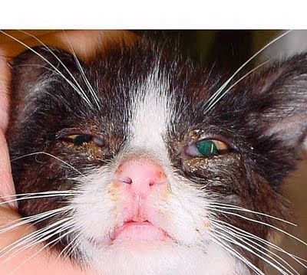
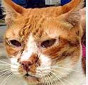
Feline Respiratory Disease Complex
Laura Blotzke
Kristen Hicks

Slide 2
Etiology
FVR -feline viral rhinotrachitis (herpes virus)
FCV -feline calicivirus
C psittaci –(chlamydia)
45-55% of feline upper respiratory infections are caused by dual infections of FCV & FVR
Other organisms such as C psittaci, mycoplasma spp. and renoviruses are believed to account for remaining infections.

Slide 3
History
FVR originated in the United States in 1958.
The first evidence of infection with FCV of marine origin can be traced to 1932.
During 1987-1996, 619 cases of C psittaci in humans were reported to the Centers for Disease Control and Prevention (CDC).
  However, we could not find any history of when this disease began to affect felines.

Slide 4
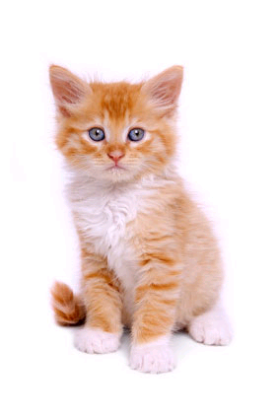
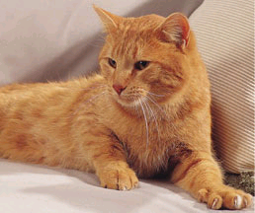
Signalment
Felines of any age can be exposed to this pathogen. However it is most difficult to treat in young kittens and aged cats.
Calicivirus (FCV) has also been found in cats with lymphocytic-plasmacytic gingivitis.

Slide 5
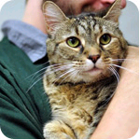
Transmission
Natural transmission can occur via aerosol droplets & formites can be carried to susceptible cat by handler.
Calicivirus is shed continuously.
FVR is released intermittently
  Stress may precipitate a secondary course of illness.
The zoonotic pathogens of this disease complex are…
  FCV
  C psittaci (rarely transmitted to humans).

Slide 6
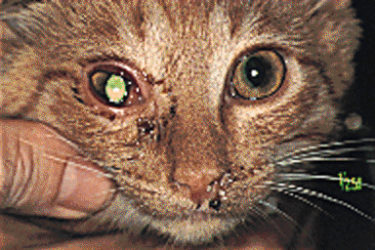
Clinical Signs
Some of the prominent clinical signs vary depending on which pathogen is the infectious pathogen.
FVR & FCV is marked by:
  Transient fever
  Frequent sneezing
  Conjunctivitis
  Rhinitis
  Excessive salivation

Slide 7

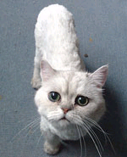
Clinical Signs of Severe Cases of FVR & FCV
Serous nasal & ocular discharge
  Soon becomes mucopurulent & copious.
Depression & anorexia are evident.
Severely debilitated cats may develop ulcerative stomatitis & ulcerative keratitis.
Signs may persist for 5-10 days in mild cases
However, may continue for up to 6wks in severe cases

Slide 8
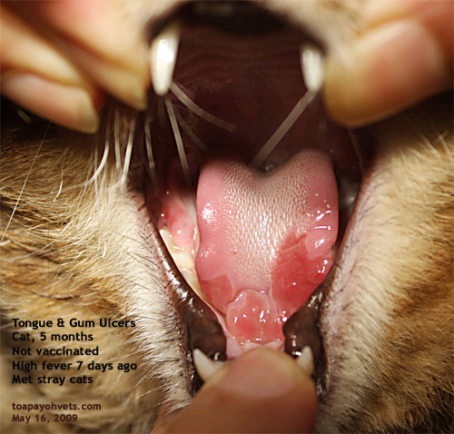
Additional Signs for Calicivirus-FCV
Some Calicivirus is non-pathogenic.
Ulcerations of tongue & hard palate or nostrils.
Pulmonary edema & interstitial pneumonia
Alternating leg lameness.
Pain in affected joints.

Slide 9
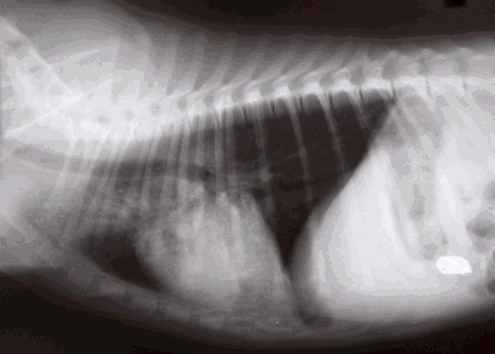
Clinical Signs for C psittaci
Conjunctivitis
Nasal discharge
Sneezing
Pneumonia
Often shed via ocular discharge.

Slide 10
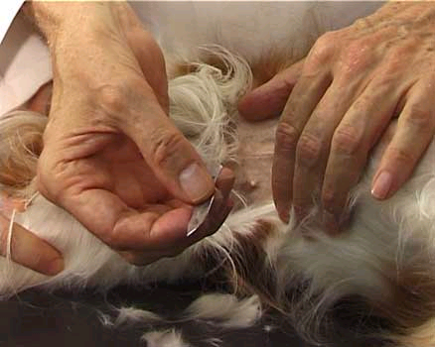
Diagnostic tests
PCR/culture
Mostly diagnosed by clinical signs such as sneezing, conjunctivitis, rhinitis, lacrimation, salivation, oral ulcers, and dyspnea.
  FVR tends to affect the conjunctivae & nasal passages.
  FCV tends to affect oral mucosa and lower respiratory tract.
Cytologic examination of conjunctival scrapings is of value for the identification of Chlamydiae.
A definitive diagnosis is based on isolation & identification of the agent.
Preferred sampling of oropharyngeal mucosa, external nares, and conjunctival sacs.
However diagnosis of FVR may be difficult due to intermittent shedding of virus.

Slide 11
Diagnosis
The presumptive diagnosis is based on the typical clinical signs, such a sneezing, conjunctivitis, rhinitis, lacrimation, salivation, oral ulcers, & dyspnea.
A definitive diagnosis is based on isolation, & identification of agent.
  Oropharyngeal mucosa, external nares, & conjunctival sacs are the preferred sampling sites.

Slide 12
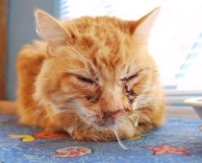
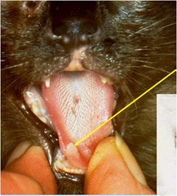
Lesions
Lesions generally occur in the respiratory tract, conjunctivae, and oral cavity.

Slide 13
FVR
Conjunctivae and nasal passages are reddened, swollen, and covered with serous to purulent exudates.
The characteristic histologic lesion of FVR is the acidophilic intranuclear inclusion body.
During the early stage of illness, inclusions may be present in the upper respiratory tract & nictitating membranes.
In severe cases, focal necrosis of the serous membranes may occur.

Slide 14
FCV
The characteristic lesion cause by FCV is ulceration of the oral mucosa.
Lesions on the tongue or hard palate initially may appear as vesicles, which subsequently rupture.
These ulcerations are occasionally found on the epithelium covering the median nasal septum.
In severe cases caliciviruses destroy epithelial cells of the bronchioles & alveoli, which causes acute pulmonary edema that progresses to seropurulent bronchiolar hyperplasia & interstitial pneumonia.

Slide 15
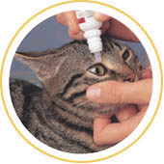
Recommended Treatment
Broad-spectrum antibiotics
Nasal and ocular discharges should be removed frequently for the comfort of the cat
Nebulization or saline nasal drops
If corneal ulcers occur in FVR infections ophthalmic preparations are indicated in addition to other antibiotic preparations.
Lysine (250mg PO bid-tid) interferes with herpetic viral replication and may reduce severity of FVR.
Antihistamines may be beneficial early in course of disease.
If dyspnea is severe, cat may be placed in oxygen tent.
Fluids may be given in severe cases of dehydration.

Slide 16
Prognosis
Rhinotracheitis has a 2-6 day incubation period.
  Cat will be infectious for 24 hrs.
  The virus is shed for 1-3 weeks thereafter.
Calicivirus has a 2-6 day incubation period.
  Clinical course of disease is 7-10 days.
  Disease is shed continuously for 2-3 weeks.
  This disease has a high mortality rate of up to 60% in severe cases.
C psittaci has a 5-10 days incubation period.
  Clinical signs will resolve with treatment.
Cats diagnosed with FVR will be chronic carriers for life.

Slide 17
Prevention
The most effective step by far is to vaccinate all cats, but even then, control is not 100 percent. Vaccination will not eliminate the chronic carrier states.
There are 2 types of modified live virus vaccines available.
First type is for parenteral administration.
  The second type should be administered to healthy cats by instillation into the conjunctival cul-de-sacs & nasal passages.
  Modified live virus FVR-FCV vaccines intended for parenteral administration are valuable in combination with either chemically inactivated, or modified live virus feline panleukopenia vaccines.
There is also vaccine composed entirely of inactivated viruses.
Vaccines containing either chick-embryo or cell-line-origin C psittaci are administered parenterally.
  These vaccines are indicated in catteries or on premises where C psittaci infection has been confirmed.
The Chlamydia (C psittaci) vaccines are available in combination with FVR-FCV and panleukopenia vaccines.

Slide 18
FYI
Chronic Carrier State….. Almost all cats who have been infected with FVR will become chronic carriers.\
FVR lives and multiplies in the cells lining the throat. During periods of stress (such as illness, anesthesia, surgery, lactation, medication with steroids, or even emotional stresses), the cat’s immunity breaks down and the virus is shed in mouth secretions. At this time, the cat may exhibit signs of a mild upper respiratory illness.
Prevention: The most effective step by far is to vaccinate all cats, but even then, control is not 100 percent. Vaccination will not eliminate the chronic carrier states.

Slide 19
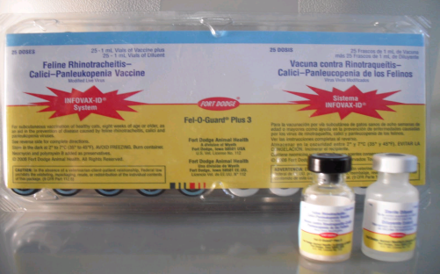
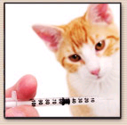
Client Education
The best way to keep your feline friend disease free is to vaccinate them as recommended by their veterinarian.
Control of environmental factors (such as exposure to sick cats, overcrowding, & stress) provide excellent protection against upper respiratory diseases.
Cats inoculated oronasally may sneeze 4-7 days after vaccination.
With modified live virus vaccines some cats show mild clinical signs of disease that should resolve itself, unless the cat was vaccinated while immunosurpressed.

Slide 20
References
www.merekvetmanual.com/mvm/index.jsp
www.pets.webmd.com/cats/feline-viral-respiratory-disease-complex?page=2
www.maxhouse.com/Resp_DI_.comp.htm

